Slide 1
HP IMES Status Diagram
Vincent Lee

Slide 2
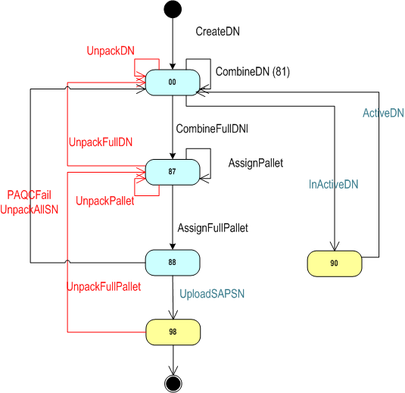
Delivery Status Diagram
CreateDN event
Upload PO
CombineDN event
81 station combine DN &COA
CombineFullDN event
81 station last production will be combined in DN
AssignPallet event
PD PA Label2 92 station
AssignFullPallet event
92 station will be last product in this Pallet
UploadSAPSN event
upload SAP SN
InActiveDN event
Withdraw DN
ReAssignDN event
UnpackFullPallet event
9P Station per productID
UnpackPallet event
9P Station per ProductID
UnPackFullDN event
SP Station per productID
UnPackDN event
SP Station per ProductID

Slide 3
COA Status Diagram

